Slide 1

QuantumAI-Climate-Projects
Womanium Quantum+AI Project
Arijeet Sarangi

Slide 2
Problem Statement
Introduction:
Climate Change: One of the most pressing challenges of our time, with far-reaching impacts on ecosystems, economies, and human societies.
Complexity of Climate Systems: Climate systems are inherently complex, involving numerous interacting components such as atmospheric circulation, ocean currents, and energy flows.
Objective:
Advanced Modeling Needs: To tackle these complexities, there’s a need for advanced modeling and simulation techniques that can accurately predict climate patterns, assess potential impacts.
Specific Problems Addressed:
Atmospheric Simulations: Traditional models struggle with the fine-scale accuracy needed for predicting weather patterns and atmospheric flows.
Climate Prediction: Existing AI models often lack the precision or computational efficiency needed for real-time or large-scale climate predictions.
Battery Materials Simulation: Developing efficient, sustainable energy storage solutions is crucial for reducing carbon emissions, but simulating materials at quantum level remains challenging.
Light Interaction with Clouds: Understanding how light interacts with water droplets in clouds is key to improving climate models, yet current methods are limited by classical computing constraints.
Project Focus:
This project explores how Quantum Computing and Artificial Intelligence can be harnessed to solve these critical issues, pushing the boundaries of what’s possible in climate science.

Slide 3
Problem Solution
Atmospheric Simulations:
Challenge: Accurate simulation of atmospheric flow and circulations is crucial for weather prediction and climate modeling, but classical methods often fall short in precision.
Solution: We implemented Quantum Phase Estimation (QPE) and Variational Quantum Eigensolver (VQE) algorithms to simulate atmospheric dynamics.
These quantum algorithms allow us to solve complex differential equations more efficiently, leading to enhanced accuracy in modeling atmospheric flows, such as wind patterns and pressure systems.
Climate Prediction:
Challenge: Predicting climate changes with high accuracy requires processing vast amounts of historical data, which can be computationally intensive.
Solution: We have utilized machine learning techniques such as deep learning and time-series analysis.
These models were trained on historical climate data, enabling them to predict future climate scenarios.
The AI model was optimized to run efficiently on standard laptops and PCs, making advanced climate prediction accessible even with limited computational resources.
Battery Simulation:
Challenge: Simulating battery materials at the quantum level is essential for developing next-generation energy storage solutions that are more efficient and environmentally friendly.
Solution: We used quantum computing methods, specifically VQE and QPE, to model the properties of battery materials.
These simulations help in understanding the material's behavior at the molecular level, which is critical for designing better batteries.
The quantum algorithms we employed can significantly reduce the computational complexity of these simulations, potentially leading to faster development cycles for new battery technologies.

Slide 4
Continued...
Light Interaction with Clouds:
Challenge: Accurately modeling how light interacts with water droplets in clouds is vital for improving climate models, but classical methods often oversimplify these interactions.
Solution: We combined Quantum Computing and AI to simulate light scattering and absorption in clouds.
The quantum component of the model handles the complex quantum mechanical interactions of light with particles, while the AI component processes and predicts outcomes based on large datasets.
This hybrid approach improves the accuracy of cloud simulations, which is crucial for predicting weather patterns and understanding climate change impacts.

Slide 5
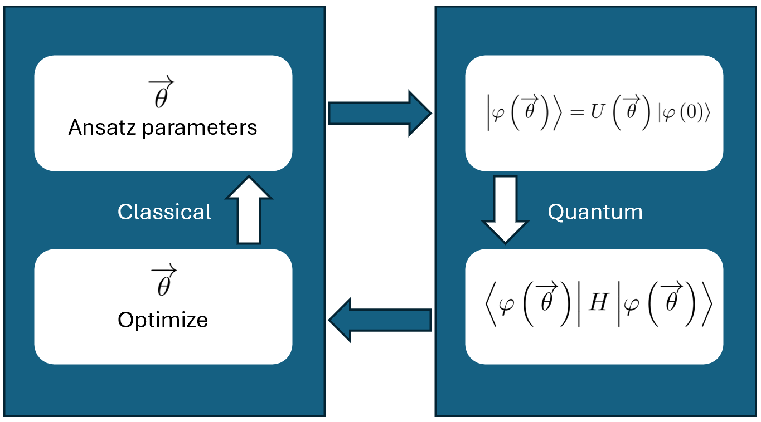
Success and Impact
Success Metrics:
Improved atmospheric simulation accuracy.
Created a fast-running AI model for climate prediction that can run on standard PCs.
Demonstrated quantum algorithms’ potential in simulating battery materials with enhanced precision.
Developed models to better understand light scattering in clouds, contributing to more accurate climate models.
Impact:
These projects show the potential of integrating Quantum Computing with AI to address complex climate challenges, setting a foundation for future advancements in this field.
A VQE Schematic

Slide 6
Future Scope
Next Steps:
Scaling models for global climate simulations.
Enhancing quantum algorithm efficiency for broader applications.
Expanding the AI model’s training data to include more variables.
Incorporating real-time data for dynamic simulations.
Current Limitations:
Limited access to quantum hardware and computational resources. Need for more extensive datasets for AI models.
References:
Wen, Jingwei & Lv, Dingshun & Yung, Man‐Hong & Long, Gui. (2021). Variational Quantum Packaged Deflation for Arbitrary Excited States. Quantum Engineering. 3. 10.1002/que2.80.
arXiv:2407.16107v1. 23 Jul 2024. Efficient variational quantum eigensolver methodologies on quantum processors
Acknowledgement:
Entire Womanium Team !!

Slide 7
Thank You !!!

